Slide 1
DATA SCIENCE
10 WEEK PART TIME COURSE
Natural Language Processing

Slide 2
AGENDA
Natural Language Processing
Case Studies
Techniques for NLP
Lab
Discussion

Slide 3
While Greg is talking
pip install spacy
If you get errors on Windows about needing libraries and development tools, install them (e.g. http://aka.ms/vcpython27 )
python –m spacy download en
If you are on Windows and you get an error about symlink(), do this:
(In Python) import sys ; print(sys.prefix)
cd to this directory
(e.g cd D:\Users\gregb\AppData\Local\Continuum\Anaconda2\Lib\site-packages )
Edit pathlib.py … comment out line 1167
#self._accessor.symlink(target, self, target_is_directory)
Re-run python mklink /j spacy\data\en en_core_web_sm\en_core_web_sm-1.2.0
–m spacy download en

Slide 4
Testing that spacy is working
import spacy
nlp = spacy.en.English()
text = nlp(u'I am a frog’)
[(token, token.pos_) for token in text]
The output should look something like this:
[(I, u'PRON'), (am, u'VERB'), (a, u'DET'), (frog, u'NOUN')]

Slide 5
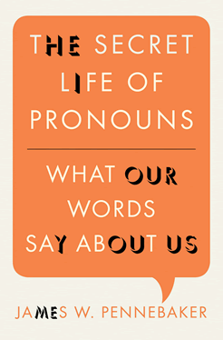
Greg’s Reading Suggestion
How Tweets and Facebook posts can tell us about the personality of their authors.
Why lying to others and to ourselves causes us to talk differently.
How it’s possible to predict if two people will fall in love by counting the function words the two people use in their first conversation with one another.
When we can predict a person’s age, sex, where they live, and what their background is by analyzing their conversations or emails.
Why self-confident leaders rarely use the word “I” and insecure and depressed people do.
How writing about an emotional upheaval using particular linguistic styles can help you get past it.
Why analyzing your own emails, letters, and natural conversations can tell you about yourself and the relationships you cherish most.

Slide 6
From text to features
DATA SCIENCE PART TIME COURSE

Slide 7
What Natural Language Processing looks like
Big blob of text
???
Features for a model

Slide 8
The goal
A dataframe
Each row is a document
Columns represent features
Do something with the dataframe:
Predict a column from the others?
Cluster documents?
Title | Number of words | Ratio of personal pronouns | Soliloquy to a skull
Alice in Wonder-land | 34110 | 0.1% | No
Hamlet | 37360 | 0.3% | Yes
Persuasion | 98171 | 0.7% | No

Slide 9
Methods
Compare against giant corpora
Count occurrences of words
Count occurrences of pairs and triples of words
Take ratios
Find word combinations that are probabilistically unusual
Parse sentences into nouns, verbs, adjectives
Chunk into noun phrases, etc.
Turn sentences into vectors
A large and structured set of texts
e.g. the Brown Corpus, contains 500 samples of English- language text, totaling roughly one million words, compiled from works published in the United States in 1961

Slide 10
Why does this work even without understanding?
Spooky personality effects on writing
http://www.hackerfactor.com/GenderGuesser.php
There aren’t that many ways to say things
We personify / anthropomorphise
Shallow Understanding

Slide 11
Low-level Shallow Deep
Lexical parsing Morphological (word) segmentation Optical character recognition (OCR) Part-of-speech (POS) tagging Sentence boundary disambiguation Speech/phoneme segmentation | Automatic summarization Named entity recognition (NER) Sentiment analysis Speech recognition Topic segmentation and recognition Word sense disambiguation | Machine translation Natural language generation Natural language understanding

Slide 12
Python NLP Packages
 | Pros | Cons
NLTK: Natural Language Toolkit | Well-documented Well-understood | Unsuitable for high-performance applications
Gensim: Topic Modeling for Humans | Built-in distributed computing support Can index datasets larger than RAM Great docs, tutorials | Narrow application focus Smaller support community (than NLTK)
Sklearn | Part of familiar set of tools for Machine Learning Good lib to explore small datasets | Limited set of NLP features “Blows up with memory errors much sooner than other libs”
corenlp: Wrapper for Stanford Core NLP | Stanford Core NLP ... Written in Java | Python wrapper around a package written in Java Relatively little support
spacy | New gold standard for serious NLP work | Less well-known

Slide 13
Using spacy
DATA SCIENCE PART TIME COURSE

Slide 14
Getting a document
import codecs
f = codecs.open('filename.txt', encoding='utf-8')
# spaCy works with unicode text, not ascii
import spacy
nlp = spacey.en.English()
Text = nlp(f.read())

Slide 15
WORD-SENTENCE SEGMENTATION
The standard approaches to locate the end of a sentence:
If it's a period, it ends a sentence
If the preceding token is in the hand-compiled list of abbreviations, then it doesn't end a sentence
But if the next token after an abbreviation is capitalized, then it ends a sentence.
This strategy gets about 95% of sentences correct.
(Source: Wikipedia)
It fails badly on Markdown documents. It needs a tuned segmenter for this.

Slide 16
Spacey does word and sentence segmentation
Text = nlp(u'This is a sentence. So is this.')
for sentence in Text.sents:
print(sentence)
for word in Text:
print(word.orth_)
# Or split by sentences first
for sentence in Text.sents:
for word in sentence:
print(word)

Slide 17
Lexical diversity
How many different words were used?
How many words in the whole text?
High ratio: rich, intelligent, challenging text
Low ratio: high redundancy, repetitious
Lexical diversity drops in longer documents because eventually there aren’t enough words in any language – so normalise (e.g. middle 10,000 words)

Slide 18
Lexical diversity stability
Most authors have a steady level of lexical diversity in their writing
Uses:
Disputed authorship
Is a passage a quote from somewhere else

Slide 19
Lexical diversity with spaCy – simple version
distinct_words = len(set([token.orth_ for token in Text]))
passage_length = len(Text)
diversity = 1.0 * distinct_words / passage_length

Slide 20
Mini-LAB Which has the longer average sentence: Alice in Wonderland or Emma? Which has the greater lexical diversity?
DATA SCIENCE PART TIME COURSE

Slide 21
Visualisation and concordancing
DATA SCIENCE PART TIME COURSE

Slide 22
NLTK Text Object
Construct a “Text” from a list of words
t = nltk.Text(nltk.word_tokenize(“Once upon a time …”))

Slide 23
Interesting Text object methods
Text.concordance(search_term)
Text.similar(search_term)
Text.common_contexts(search_terms)
Text.dispersion_plot(search_terms)

Slide 24
Mini-LAB How the authors used words
DATA SCIENCE PART TIME COURSE

Slide 25
Stemming, lemmatization, Synonyms
DATA SCIENCE PART TIME COURSE

Slide 26
STEMMING/ LEMMATIZATION / SIMILARITY
LinkedIn sees 6,000+ variations on the job title, “Software Engineer”
They see 8,000+ variations on the company, “IBM”
They have to recognize all of these and understand they are the same

Slide 27
STEMMING
On a smaller scale, it is occasionally useful to strip away conjugations and other modifiers:
science, scientist → scien
swim, swimming, swimmer → swim
The resulting text is often unreadable, but retains semantic content.
spaCy has no stemmer, but NLTK has two (Porter and Snowball).

Slide 28
Tokens have a lemma form
Snowball
import nltk.stem.snowball.SnowballStemmer
Stemmer = SnowballStemmer(“english”)
Stemmer.stem(“running”)
Porter
import nltk.stem.snowball.PorterStemmer
Stemmer = PorterStemmer(“english”)
Stemmer.stem(“running”)

Slide 29
Mini-LAB How the authors used words
DATA SCIENCE PART TIME COURSE

Slide 30
WordNet synsets
import nltk.corpus.wordnet
S = wordnet.synsets(“car”)
print [x.lemma_names() for x in S]
print [x.definition() for x in S]
Parent_Concepts = S[0].hypernyms()
Child_Concepts = S[0].hyponyms()
Synset1.lower_common_hypernyms(Synset2)
Synset1.path_similarity(Synset2)

Slide 31
Part of Speech Tagging
DATA SCIENCE PART TIME COURSE

Slide 32
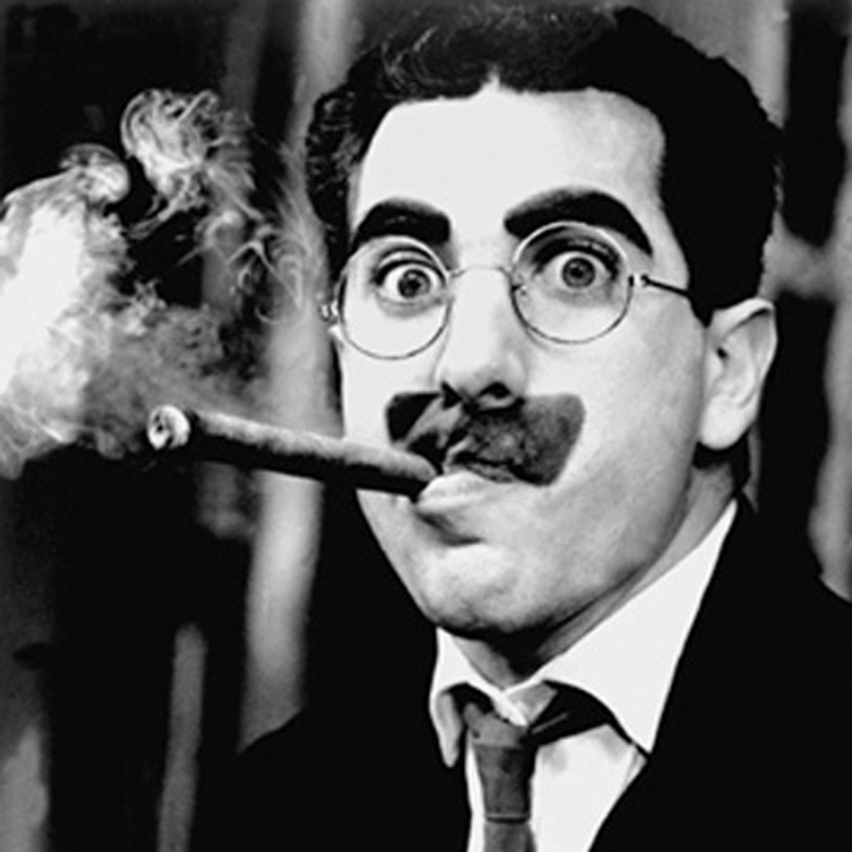
How to parse this sentence?
I shot an elephant in my pyjamas.
(Hint: the next sentence was “how he got into my pyjamas I’ll never know”).

Slide 33
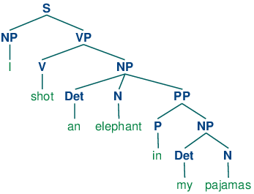
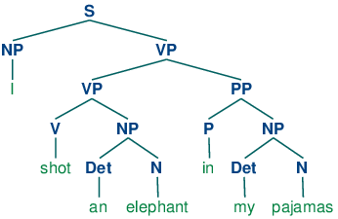
Who was in the pyjamas?

Slide 34
How to parse?
Create probability for each word as a noun, verbs, adjectives, etc.
i.e. Look up a corpus
Assign a probability for each phrase
i.e. Look up a very, very big corpus
Multiply out a lot of big matrices
i.e. Give up when you get something that looks OK
NLTK’s Perceptron tagger does OK at this:
nltk.pos_tag(nltk.word_tokenize(“I bought a frog”))
Google’s Parsey McParseface is the leader

Slide 35
Term Document Frequency
DATA SCIENCE PART TIME COURSE

Slide 36
Latent Dirichlet Allocation
DATA SCIENCE PART TIME COURSE

Slide 37
HOW COULD WE RUN SENTIMENT ANALYSIS?
DATA SCIENCE PART TIME COURSE

Slide 38
EXAMPLE - SENTIMENT ANALYSIS
Most sentiment prediction systems work just by looking at words in isolation, giving positive points for positive words and negative points for negative words and then summing up these points.
Often trained on datasets of measurable positive / negative comments (such as movie reviews)
The order of words is ignored and important information is lost
Better ones identify which topics are being referred to

Slide 39
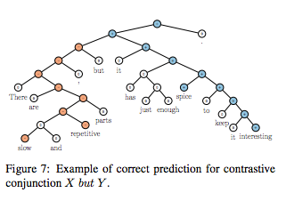
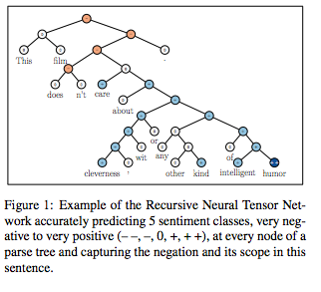
EXAMPLE - SENTIMENT ANALYSIS

Slide 40
Now for the easy version
DATA SCIENCE PART TIME COURSE

Slide 41

2000 Free lookups per day on IBM Watson
Entity Extraction
Sentiment Analysis
Keyword Extraction
Concept Tagging
Relation Extraction
Taxonomy Classification
Author Extraction
Language Detection
Text Extraction
Microformats Parsing
Feed Detection
Linked Data Support

Slide 42
Or…
Request access to the closed beta of Google cloud-text
(And get access to the speech API at the same time)

Slide 43
Or…
import blobtext
Text = blobtext.BlobText(“Greg is a nice person.”)
print Text.sentiment, Text.polarity, Text.subjectivity
print Text.parse()
print Text.word_counts
print Text.detect_language()
print Text.noun_phrases
print Text.np_count
print Text.ngrams(2)

Slide 44
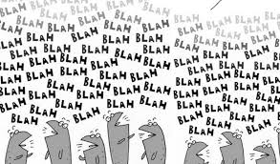
LAB & exit tickets
DATA SCIENCE PART TIME COURSE

